Slide 1


Adarsh Institute of Technology & Research Centre, Vita Department of Computer Science Engineering Class-TY(B.Tech)
Mini- Project- II Presentation on
“Website Box”
Presented by :
1.Sanika Kapse CS3051
2.Sakshi Kadam CS3052
3.Simran Kadam CS3053
4.Harshada Patil CS3054
5.Bhore Saksham CS3055
Academic Year:
2023-2024
Under Guidance of
Asst.Prof.Mr.D.K.Jadhav

Slide 2
INDEX
INTRODUCTION
OBJECTIVES
LITERATURE REVIEW
EXISTING SYSTEM
PROPOSED SYSTEM
HW/SW REQUIREMENT
SYSTEM ARCHITECTURE
SNAPSHOTS
FUTURE SCOP
CONCLUSION
REFERENCES

Slide 3
INTRODUCTION
The website box is designed for storing all website at one place which is easy for finding any website.
This is very useful for teaching staff of any college.
In short in website box there is collection of all website which is created by students of particular class.

Slide 4
OBJECTIVES
To create a centralized and user-friendly platform for a specific department within your college or university.
This platform aims to improve access to projects information, streamline communication, and enhance collaboration for faculty, staff, and students within the department.
Project aims to create a more efficient and effective system for managing and accessing projects information, ultimately benefiting all members of the projects groups.

Slide 5
LITERATURE REVIEW
Existing System
Sr. No | Title of the Paper | Authors | Publisher | Paper List
1. | Website box | John Smith | IEEE (2020) | The paper titled ”Implementing an Integrated College Management System: A LiteratureWebsite Box Review” provides a comprehensive analysis of existing literature on college management systems (CMS) and their implementation in educational institutions.
2. | Website Box | Jane Doe | IEEE(2021) | The authors review various aspects of CMS, including their functionalities, benefits, challenges, and best practices. They also explore the impact of CMS on administrative processes, academic operations, student services, and overall organizational efficiency.
3. | Website Box | Sarah Johnson | IEEE(2022) | The authors identify common challenges faced during CMS implementation, such as resistance to change, integration issues with existing systems, data migration complexities, training requirements, and maintenance costs.

Slide 6
EXISTING SYSTEM
Complicated to differentiate projects Batchwise for guide.
Difficult to understand which project is in which batch or which group.
It not possible to collect vast type of project from the students at time .
Difficult to organize all projects at a one place at a time.

Slide 7
PROPOSED SYSTEM
Easy to collect the all projects at a time in one place.
Unchallenging to differentiate projects batchwise and groupwise.
Uncomplicated to understand projects of each batch.
More effective for guide for finding project at minimum time.

Slide 8
HW/SW REQUIREMENT
HARDWARE :
1. I5 processor based computer
2. Internet connection
3.Ram 32gb or more.
4.500 GB hard disk space
SOFTWARE:
1.Programming languages: HTML,CSS,JS
2.Framework:Boostrap
3.Window 10

Slide 9
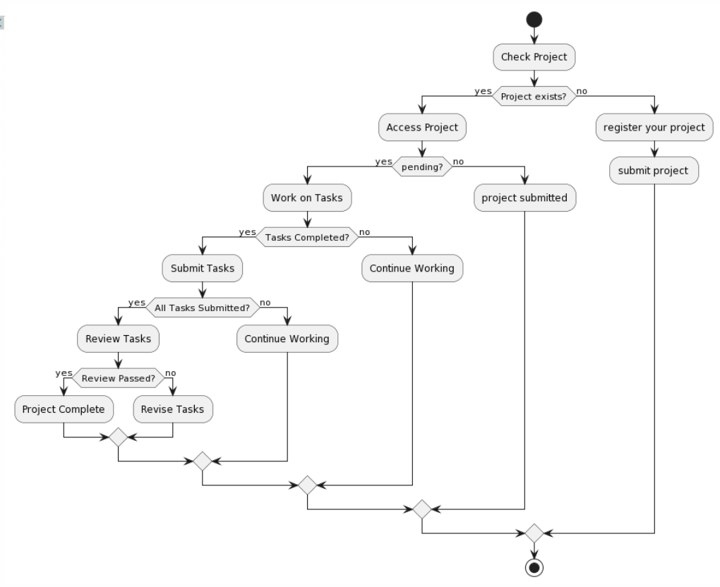
SYSTEM ARCHITECTURE

Slide 10
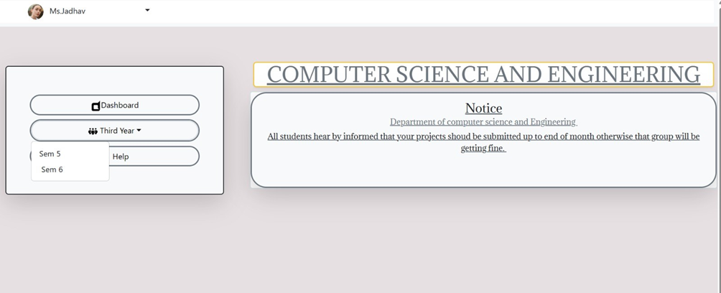
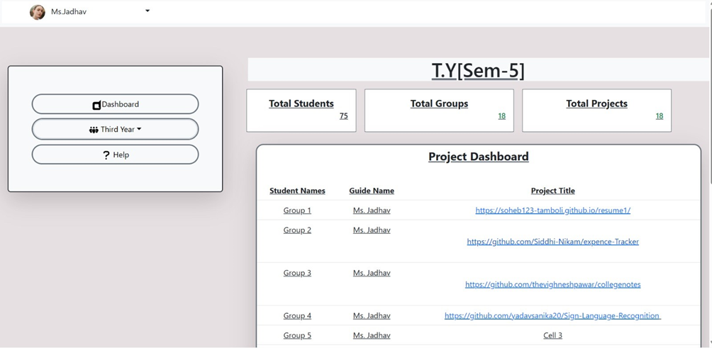
SNAPSHOTS

Slide 11
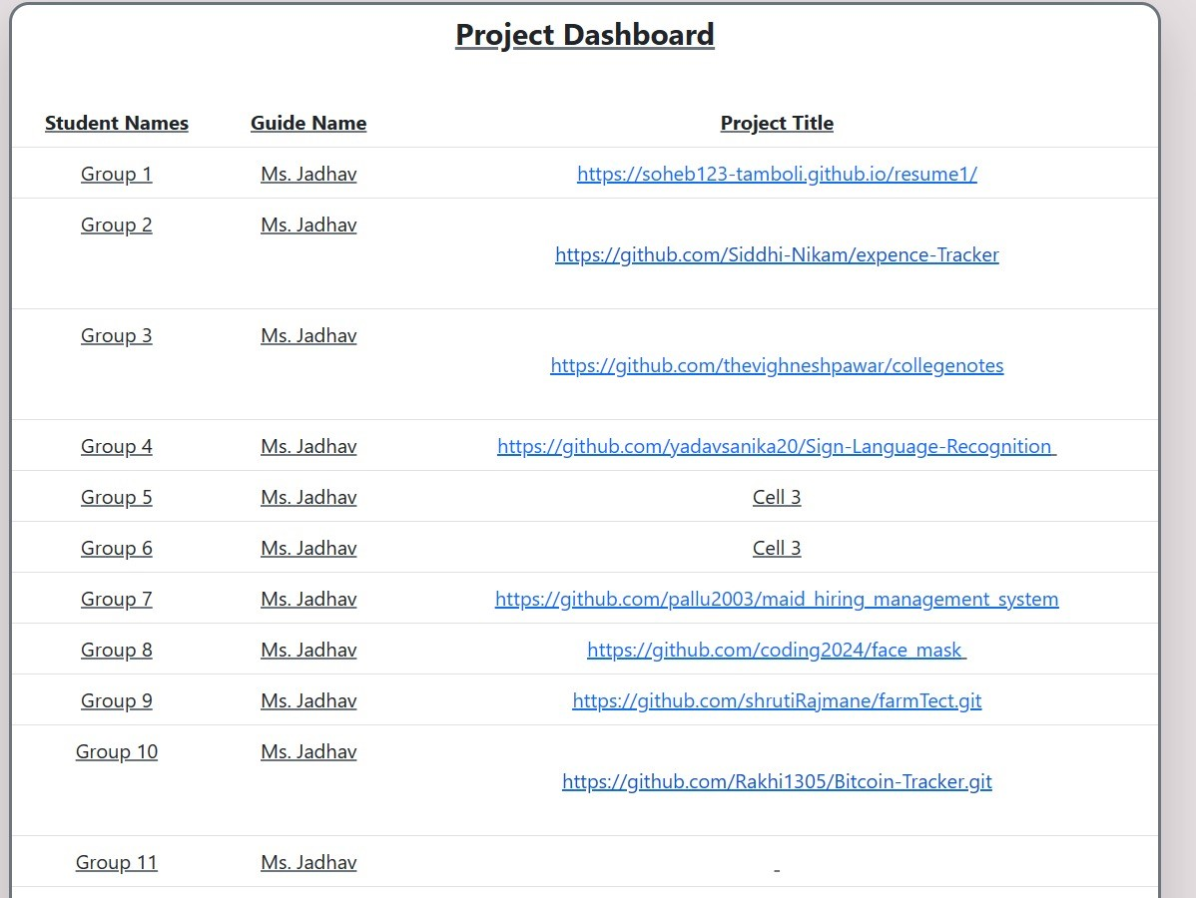
SNAPSHOTS

Slide 12
Future Scope
Each project can be represented by board with task organized into list.
It is very useful for guide as well as students.
It is straight forward to distinguish between different types of tasks, priorities or statuses.
This keeps everyone in the loop , and promotes transparent communication.
This is best platform for finding websites at one place.

Slide 13
Conclusion
Website box is useful for college purpose.
This website box is very useful for the college projects as well as office projects.
We can easily access anyone’s projects by saving time.
The main admin can hold the all control of website box.
The website box is good application for time saving. This is safe and secure for storing projects at one place .

Slide 14
REFERENCES
Gopal R. Chandangole, Aparna V. Mote, Enrichng Information Security in Educational data Mining using Big Data
LINK: https://www.ijpub.org.
R Agrawal, T 1 mielinski,A Swami. Database Mining :A performance perspective[IEEE 1993]

